Slide 1
IMPACT Guidance: Entry of Staff FTE & Percentages
Division of Prevention and Intervention Services

Slide 2
Purpose
To provide foundational technical assistance and support to help county authority prevention departments utilize best practices for completing and updating their staff lists in IMPACT
To eliminate confusion related to expectations of the number of hours reported in IMPACT per staff member
To support prevention managers in monitoring services provided and reported by both direct-hire and contract staff
To increase the professionalism of the prevention field
Prevention professionals are our greatest resource!

Slide 3
Staff for a Single County Authority
Single Role & Funding Source
Dual Roles & Funding Sources
Dual Departments & Funding Sources
Examples of Correct and Incorrect Entries in the IMPACT Staff List

Slide 4
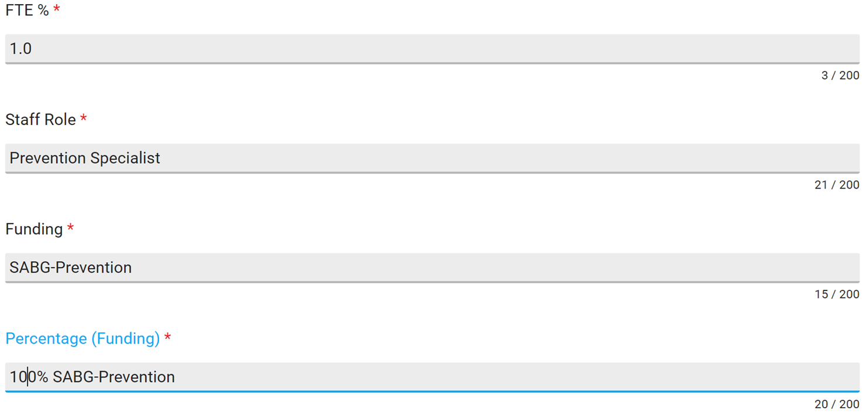
Single County Authority: Single Role & Funding Source
Name: Letsee Better Full Time Equivalency (FTE): Letsee is assigned to work full time (100%) in prevention and has one funding source: SABG Prevention Set-Aside.
Percentage (funding) equals the FTE %.

Slide 5
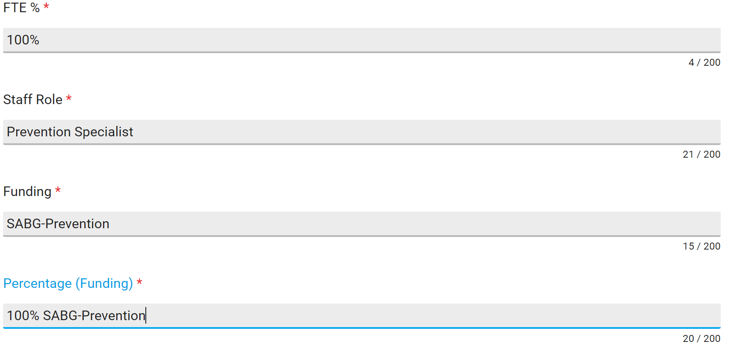
Single County Authority: Single Role & Funding Source
Name: Letsee Better Full Time Equivalency (FTE): Letsee is assigned to work full time (100%) in prevention and has one funding source: SABG Prevention Set-Aside.
Incorrect entry
z
FTE = 1.0 or less. Total level of effort per person is no more than 100% across funding sources.

Slide 6
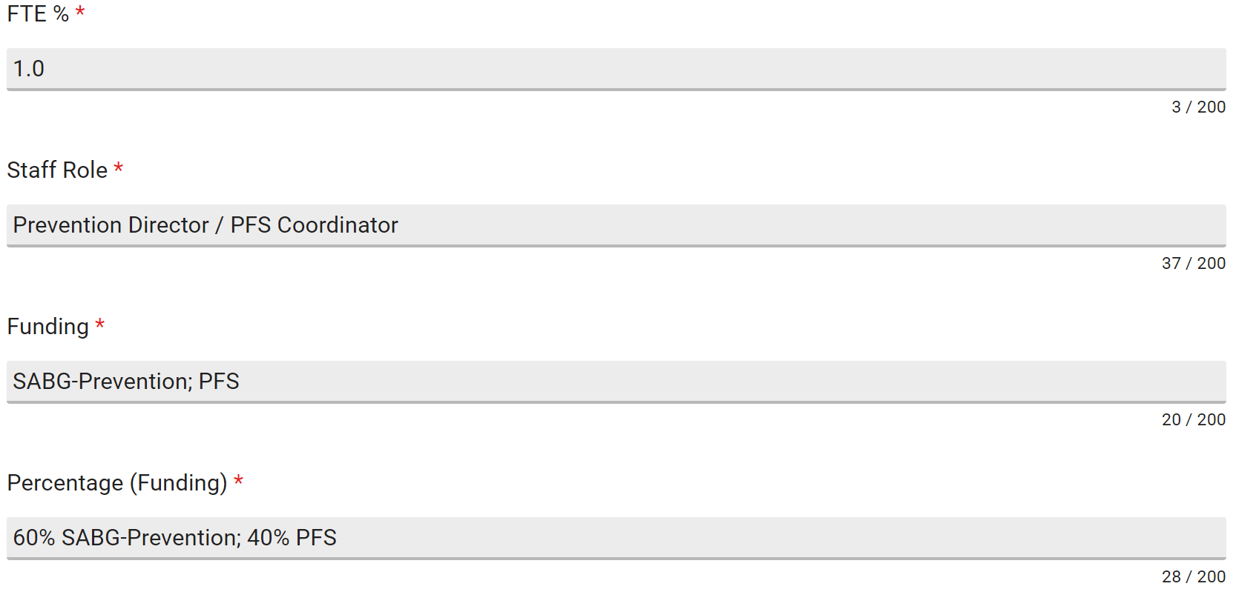
Single County Authority: Dual Roles & Funding Sources
Name: May B. Good Full Time Equivalency (FTE): May is assigned to work full time (100%) in prevention. She has two funding sources: SABG Prevention Set-Aside and Partnerships for Success (PFS).
Percentage (funding) equals the FTE %.
(0.60 + 0.40) = 1.0

Slide 7
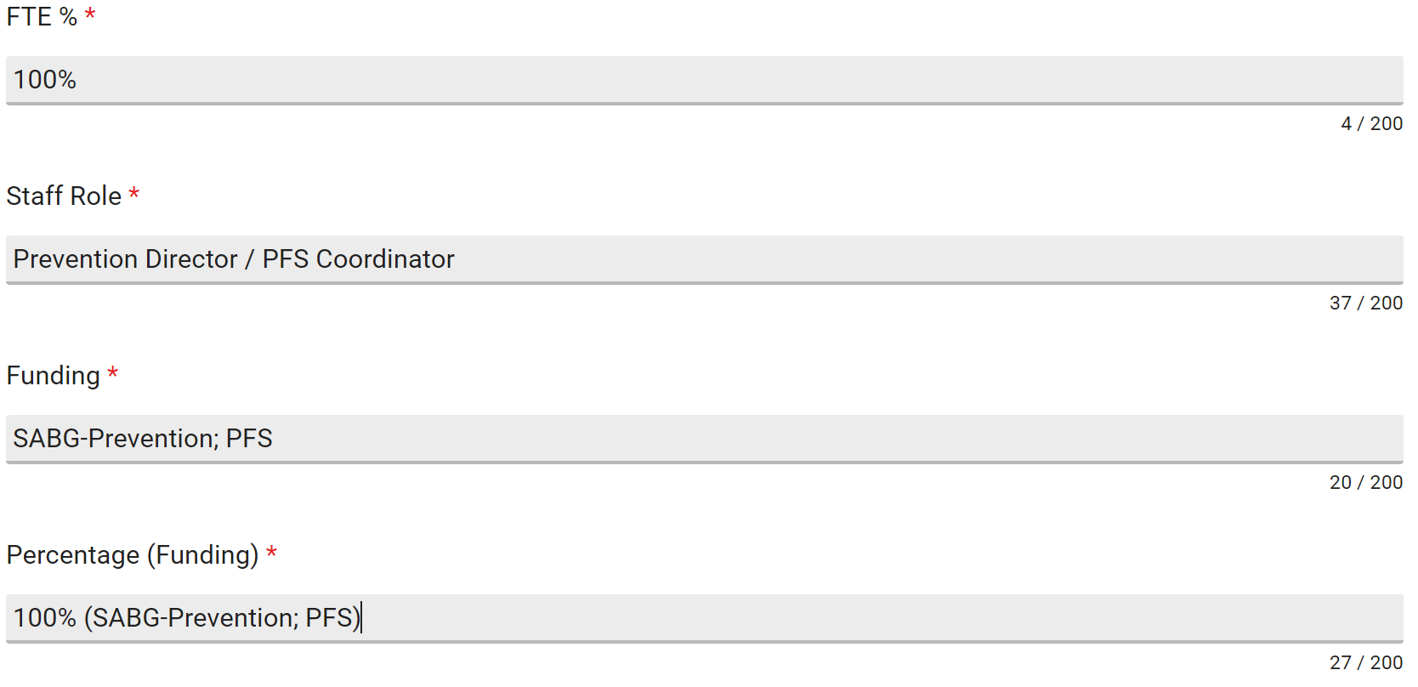
Single County Authority: Dual Roles & Funding Sources
Name: May B. Good Full Time Equivalency (FTE): May is assigned to work full time (100%) in prevention. She has two funding sources: SABG Prevention Set-Aside and PFS.
Incorrect entry
FTE = 1.0 or less. Percentage (funding) needs to reflect % per funding source.

Slide 8
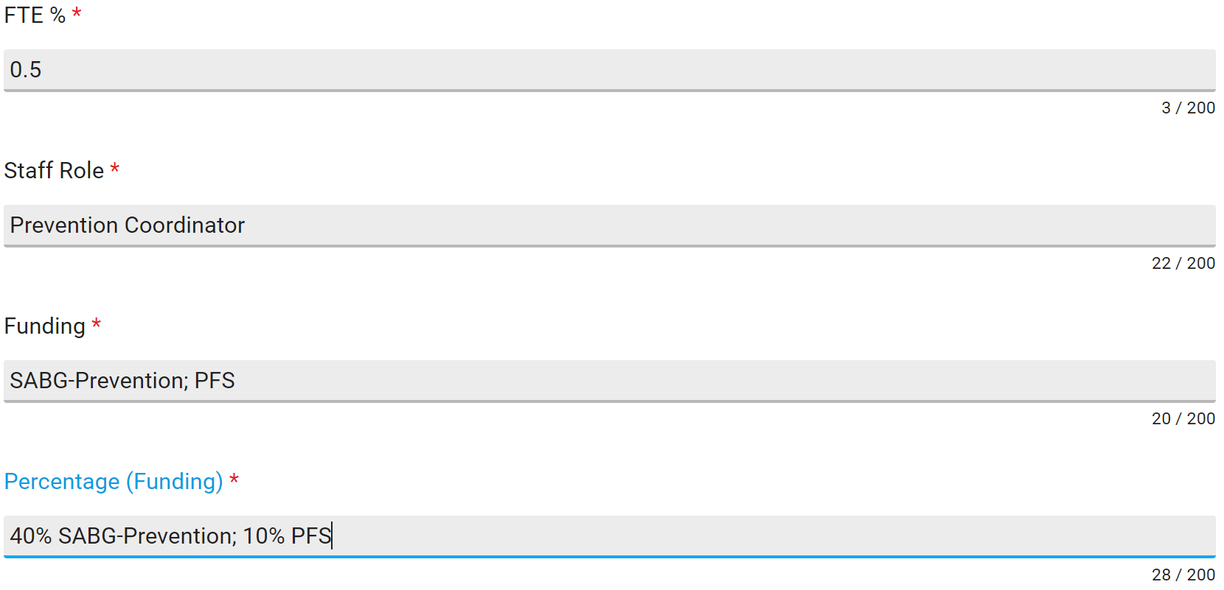
Single County Authority: Dual Departments & Funding Sources
Name: Youra Saint Full Time Equivalency (FTE): Youra is assigned to work part-time (50%) in prevention and part-time (50%) in treatment. She has two prevention funding sources: SABG Prevention Set-Aside and PFS.
Percentage (funding) equals the FTE %.
(0.40 + 0.10) = 0.5

Slide 9
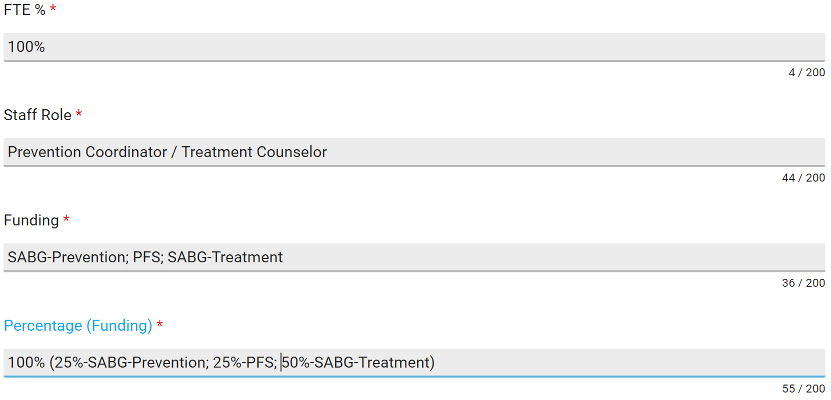
Single County Authority: Dual Departments & Funding Sources
Name: Youra Saint Full Time Equivalency (FTE): Youra is assigned to work part-time (50%) in prevention and part-time (50%) in treatment. She has two prevention funding sources: SABG Prevention Set-Aside and PFS.
Incorrect entry
Include prevention related funding sources only.

Slide 10
Staff for a Multi-County Authority
Single Role & Funding Source
Dual Roles & Funding Sources
Examples of Correct and Incorrect Entries in the IMPACT Staff List

Slide 11
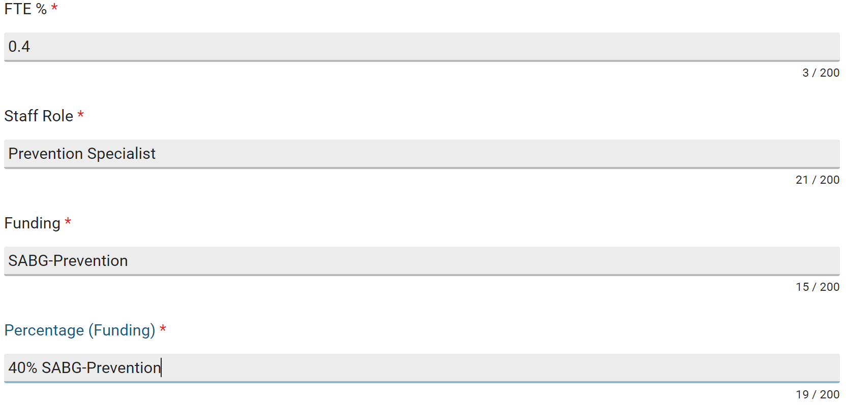
Multi-County Authority: Single Role & Funding Source
Name: Taka Spot
Full Time Equivalency (FTE): Taka’s agency serves three counties (A, B, and C). She works full-time in prevention and is assigned to work 40% in A, 35% in B, and 25% in C. She has one funding source: SABG Prevention Set-Aside.
COUNTY A
Percentage (funding) equals the FTE % per organization in IMPACT.

Slide 12
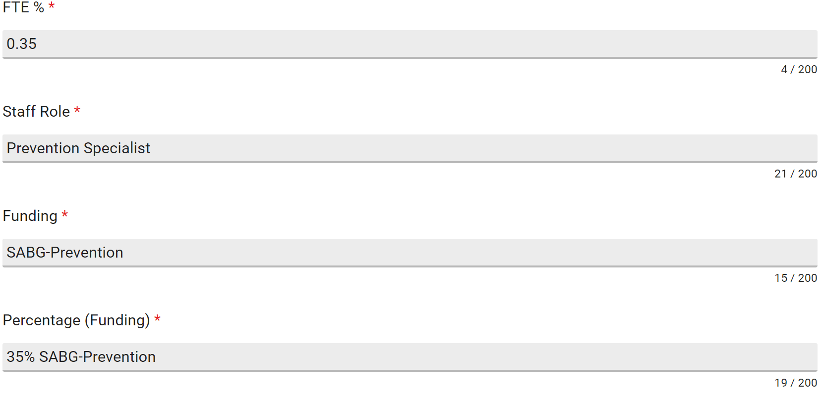
Multi-County Authority: Single Role & Funding Source
Name: Taka Spot
Full Time Equivalency (FTE): Taka’s agency serves three counties (A, B, and C). She works full-time in prevention and is assigned to work 40% in A, 35% in B, and 25% in C. She has one funding source: SABG Prevention Set-Aside.
COUNTY B
Percentage (funding) equals the FTE % per organization in IMPACT.

Slide 13
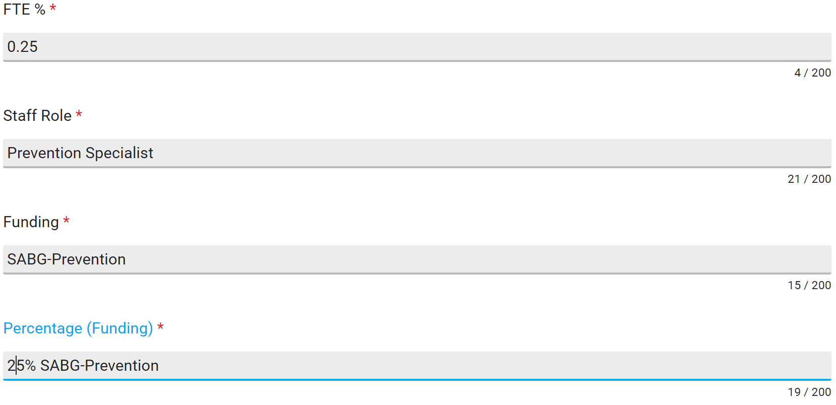
Multi-County Authority: Single Role & Funding Source
Name: Taka Spot
Full Time Equivalency (FTE): Taka’s agency serves three counties (A, B, and C). She works full-time in prevention and is assigned to work 40% in A, 35% in B, and 25% in C. She has one funding source: SABG Prevention Set-Aside.
COUNTY C
Percentage (funding) equals the FTE % per organization in IMPACT.

Slide 14
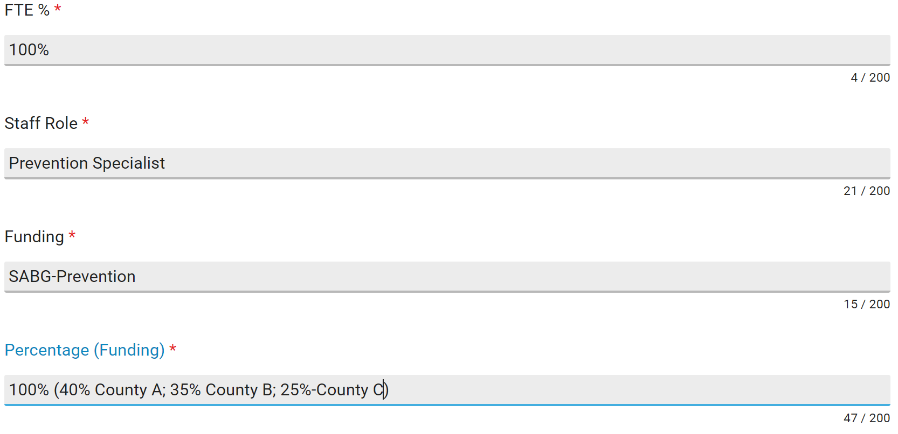
Multi-County Authority: Single Role & Funding Source
Name: Taka Spot
Full Time Equivalency (FTE): Taka’s agency serves three counties (A, B, and C). She works full-time in prevention and is assigned to work 40% in A, 35% in B, and 25% in C. She has one funding source: SABG Prevention Set-Aside.
Do not repeat staff information for each organization if staff’s FTE %, staff roles, or percentage of funding varies per county in IMPACT.
Incorrect entry
Percentage (funding) needs to equal the FTE % per organization in IMPACT; is not a combined total.

Slide 15
Multi-County Authority: Single Role & Funding Source
Name: Taka Spot
Full Time Equivalency (FTE): Taka’s agency serves three counties (A, B, and C). She works full-time in prevention and is assigned to work 40% in A, 35% in B, and 25% in C. She has one funding source: SABG Prevention Set-Aside.
County A
County B
County C
Total
FTE %: 0.40 0.35 0.25 1.0
Percentage: 40% 35% 25% 100%
Total percentage (funding) equals 100% for the three counties combined.
Total percentage (funding) equals the combined FTE % of County A, B, and C.

Slide 16
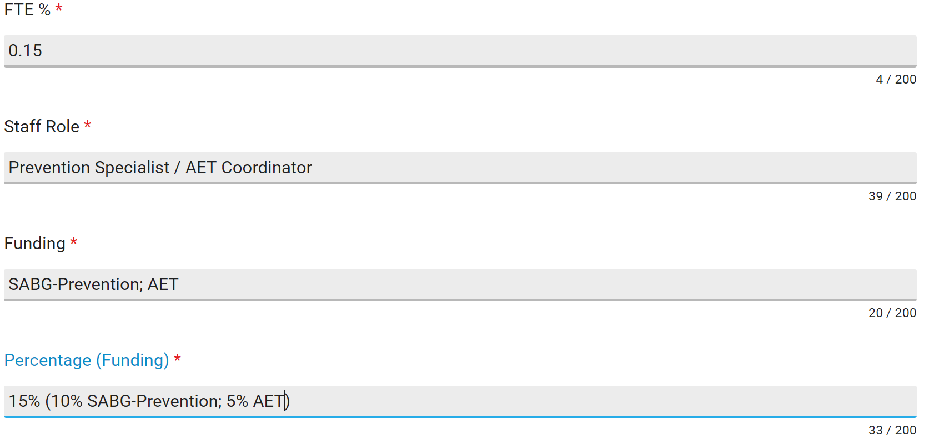
Multi-County Authority: Dual Roles & Funding Sources
Name: Max E. Mumeffort
Full Time Equivalency (FTE): Max’s agency serves three counties (A, B, and C). He works full-time in prevention and has three funding sources: SABG-Prevention Set-Aside, PFS, and Alcohol Enforcement Team (AET).
COUNTY A
Percentage (funding) equals the FTE % per organization in IMPACT.

Slide 17
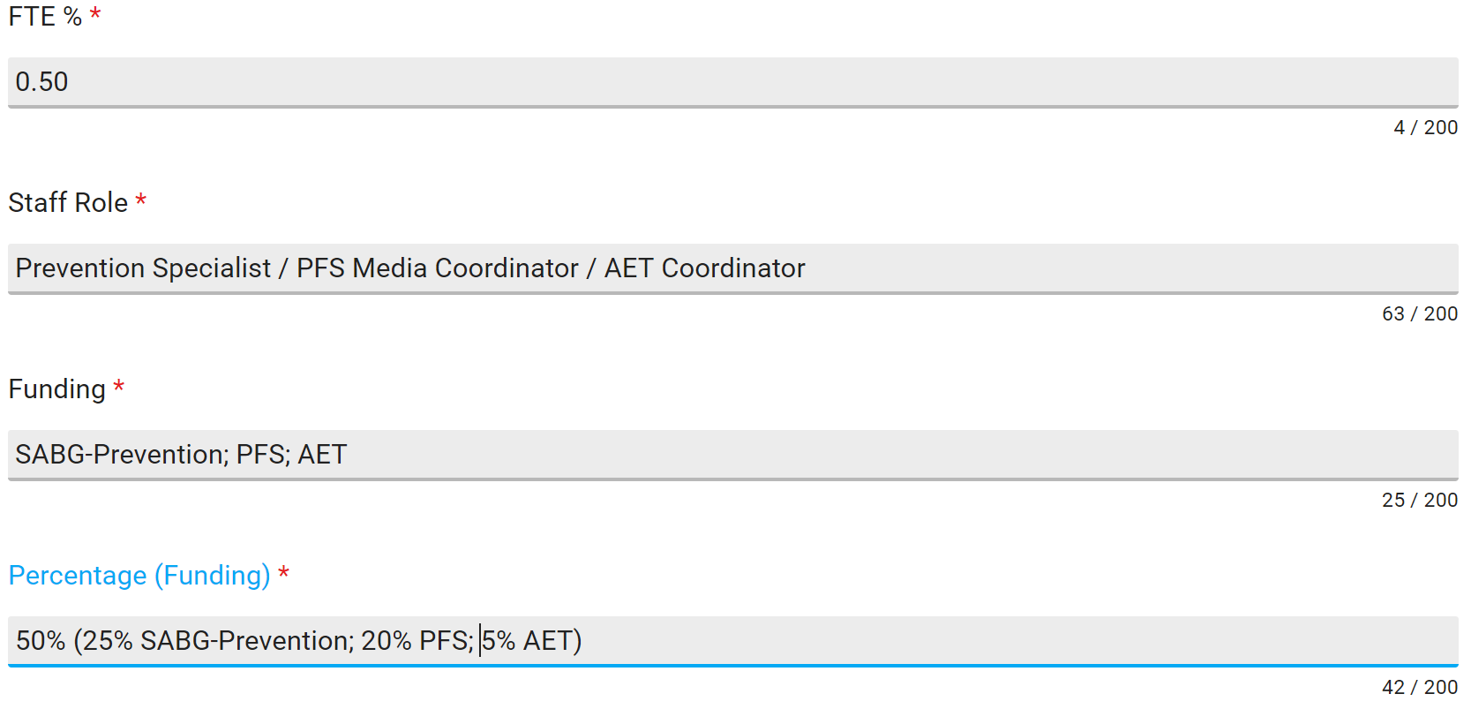
Multi-County Authority: Dual Roles & Funding Sources
Name: Max E. Mumeffort
Full Time Equivalency (FTE): Max’s agency serves three counties (A, B, and C). He works full-time in prevention and has three funding sources: SABG-Prevention Set-Aside, PFS, and AET.
COUNTY B
Percentage (funding) equals the FTE % per organization in IMPACT.

Slide 18
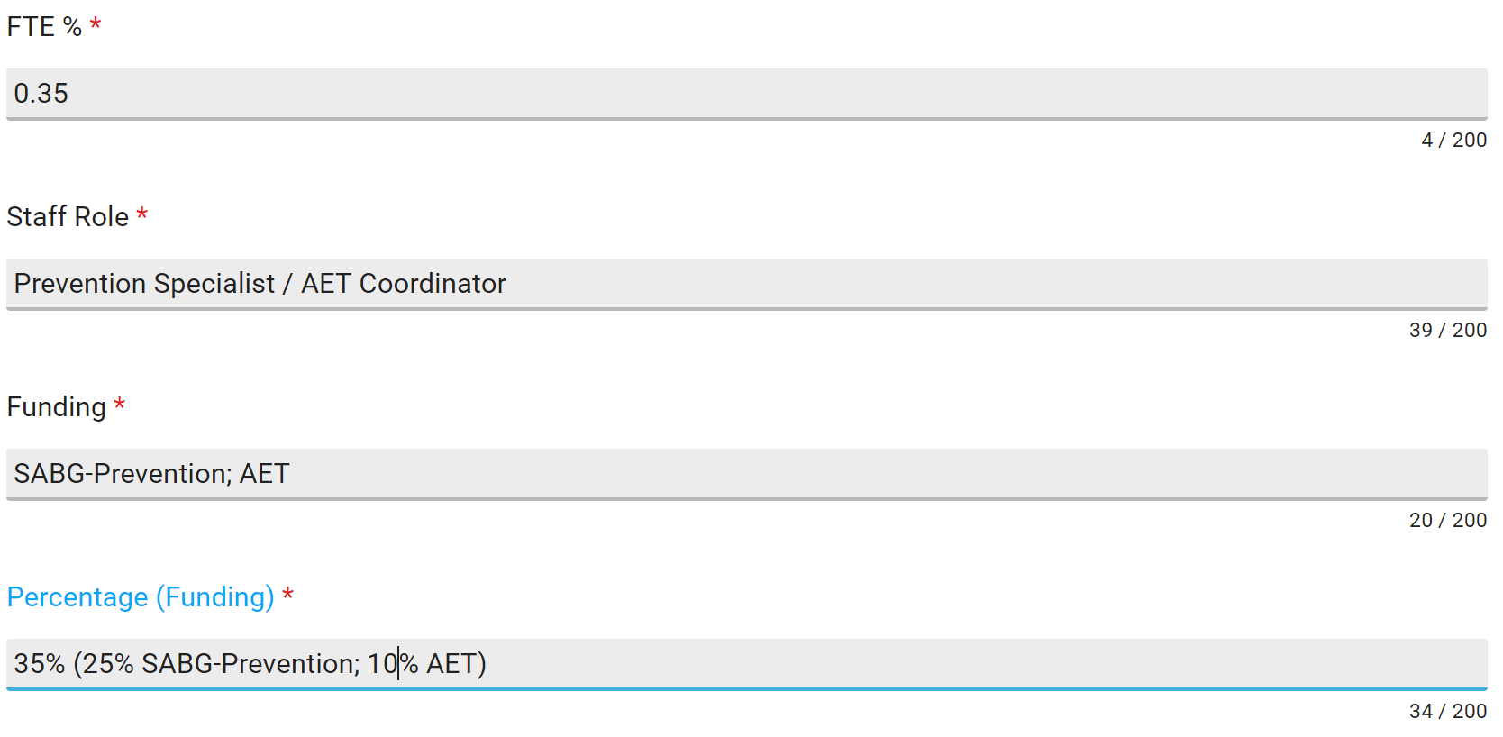
Multi-County Authority: Dual Roles & Funding Sources
Name: Max E. Mumeffort
Full Time Equivalency (FTE): Max’s agency serves three counties (A, B, and C). He works full-time in prevention and has three funding sources: SABG-Prevention Set-Aside, PFS, and AET.
COUNTY C
Percentage (funding) equals the FTE % per organization in IMPACT.

Slide 19
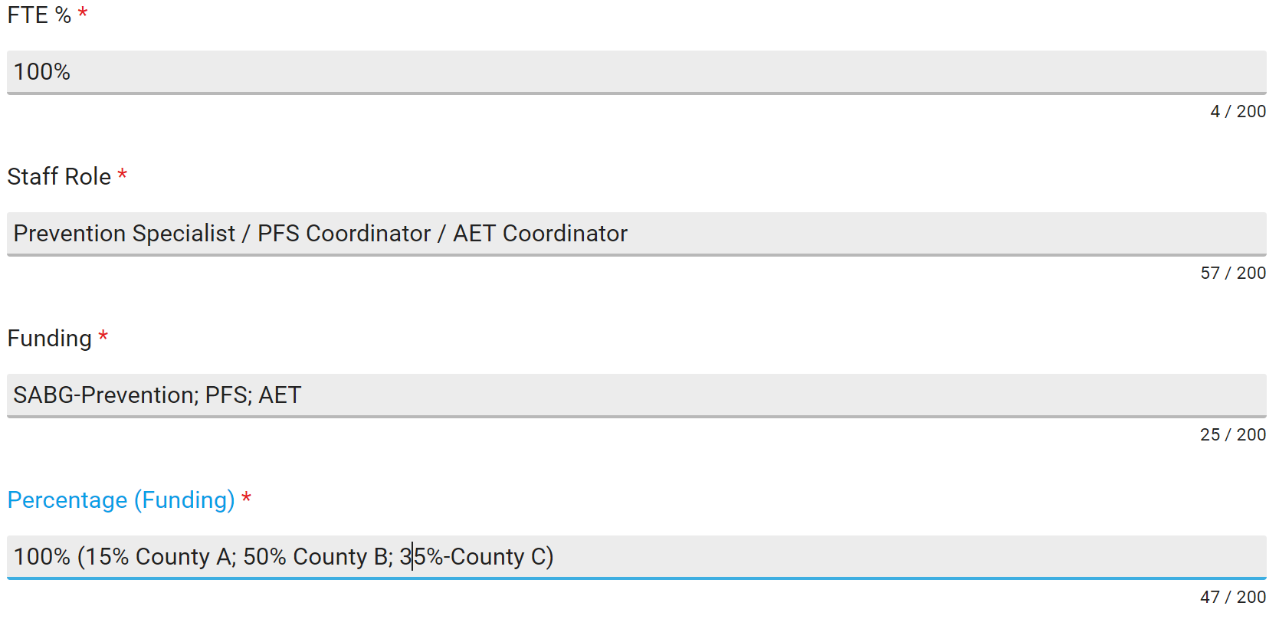
Multi-County Authority: Dual Roles & Funding Sources
Name: Max E. Mumeffort
Full Time Equivalency (FTE): Max’s agency serves three counties (A, B, and C). He works full-time in prevention and has three funding sources: SABG-Prevention Set-Aside, PFS, and AET.
Do not repeat staff information for each organization if staff’s FTE %, staff roles, or percentage of funding varies per county in IMPACT.
Incorrect entry
Only include information that pertains to staff roles per organization in IMPACT; not cumulative roles.

Slide 20
Multi-County Authority: Dual Roles & Funding Sources
Name: Max E. Mumeffort
Full Time Equivalency (FTE): Max’s agency serves three counties (A, B, and C). He works full-time in prevention and has three funding sources: SABG-Prevention Set-Aside, PFS, and AET.
FTE
County A
County B
County C
Total
SABG-Prevention: 0.10 0.25 0.25 0.60
PFS: 0.00 0.20 0.00 0.20
AET: 0.05 0.05 0.10 0.20
Percentage: 15% 50% 35% 100%
Total percentage (funding) equals 100% for the three counties combined.
Total percentage (funding) equals the combined FTE % of County A, B, and C.

Slide 21
AET Staff
Dual Prevention Roles
Single-Role Contract Staff
Examples of Correct and Incorrect Entries in the IMPACT Staff List

Slide 22
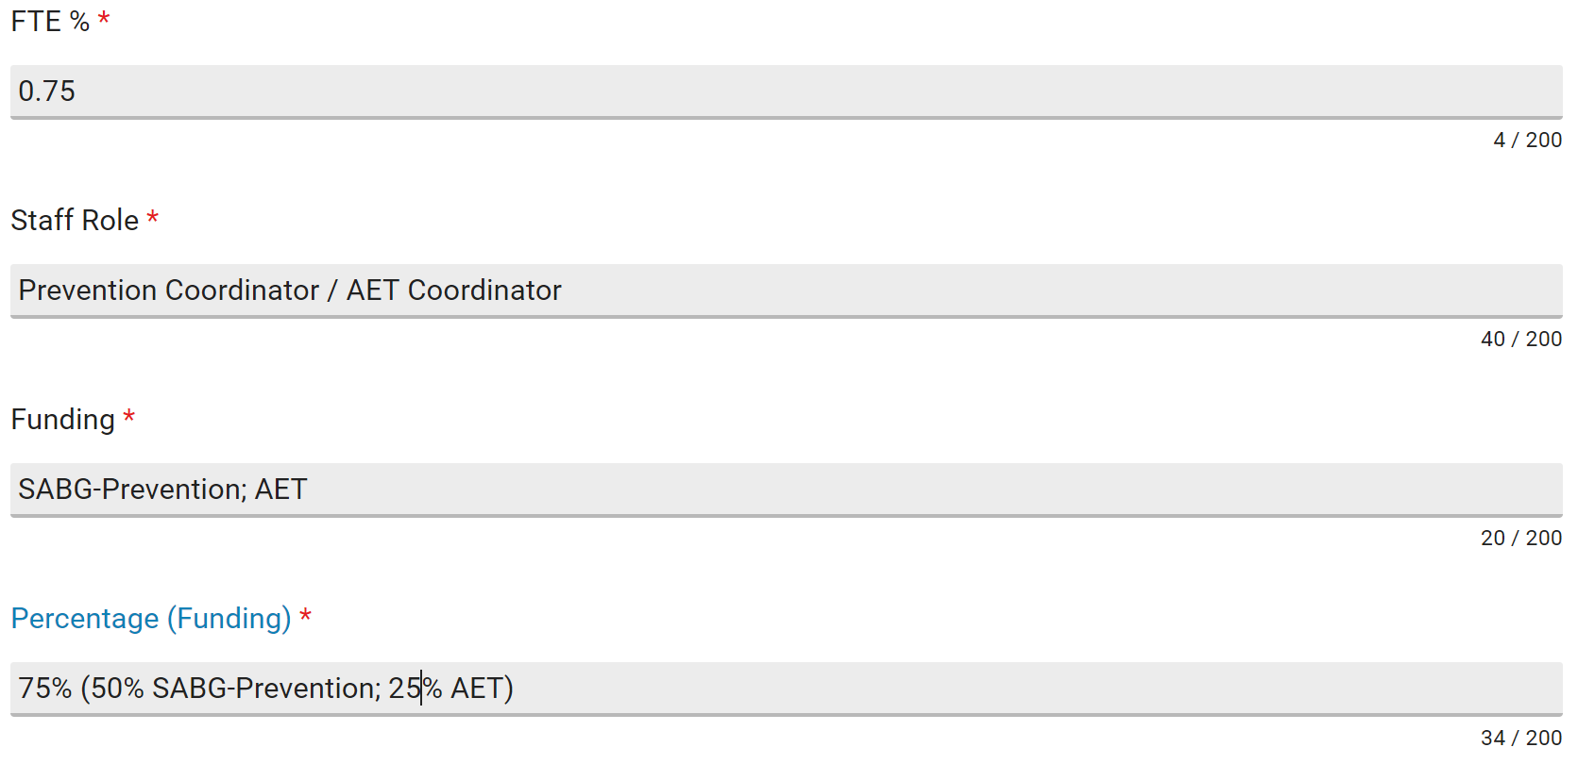
AET Coordinator: Dual Prevention Roles
Name: Karen Badge
Full Time Equivalency (FTE): Karen is the Prevention Coordinator (PC) for XYZ County. Half (50%) of her time is spent as the PC and the other half (50%) is divided equally between her AET counties (XYZ County and ABC County). She has two funding sources: SABG Prevention Set-Aside and AET.
XYZ COUNTY
Percentage (funding) equals the FTE % per organization in IMPACT.

Slide 23
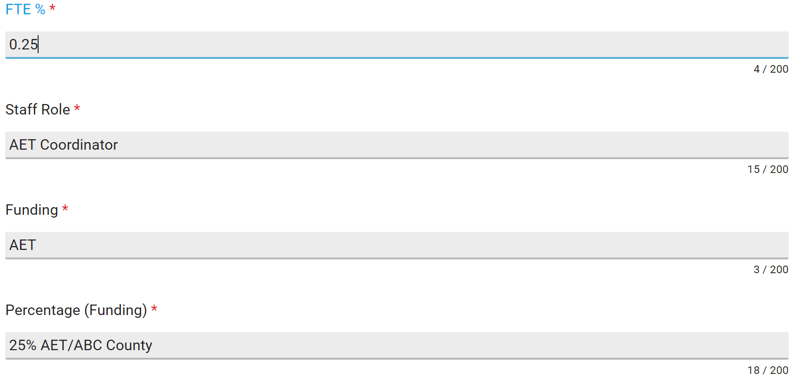
AET Coordinator: Dual Prevention Roles
Name: Karen Badge
Full Time Equivalency (FTE): Karen is the Prevention Coordinator (PC) for XYZ County. Half (50%) of her time is spent as the PC and the other half (50%) is divided equally between her AET counties (XYZ County and ABC County). She has two funding sources: SABG Prevention Set-Aside and AET.
ABC COUNTY
Percentage (funding) equals the FTE % per organization in IMPACT.

Slide 24
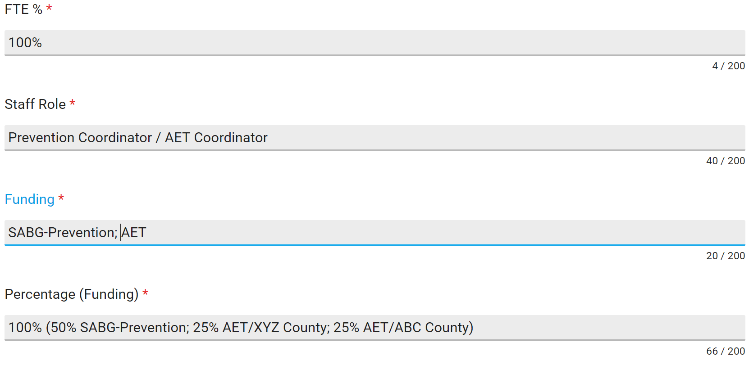
AET Coordinator: Dual Prevention Roles
Name: Karen Badge
Full Time Equivalency (FTE): Karen is the Prevention Coordinator (PC) for XYZ County. Half (50%) of her time is spent as the PC and the other half (50%) is divided equally between her AET counties (XYZ County and ABC County). She has two funding sources: SABG Prevention Set-Aside and AET.
Do not repeat staff information for each organization if staff’s FTE %, staff roles, or percentage of funding varies per county in IMPACT.
XYZ COUNTY
Incorrect entry
Percentage (funding) equals the FTE % per organization in IMPACT.

Slide 25
AET Coordinator: Dual Prevention Roles
Name: Karen Badge
Full Time Equivalency (FTE): Karen is the Prevention Coordinator (PC) for XYZ County. Half (50%) of her time is spent as the PC and the other half (50%) is divided equally between her AET counties (XYZ County and ABC County). She has two funding sources: SABG Prevention Set-Aside and AET.
FTE
XYZ County
ABC County
Total
SABG-Prevention: 0.50 0.00 0.50
AET: 0.25 0.25 0.50
Percentage: 75% 25% 100%
Total percentage (funding) equals 100% for the two counties combined.
Total percentage (funding) equals the combined FTE % of County XYZ and ABC.

Slide 26
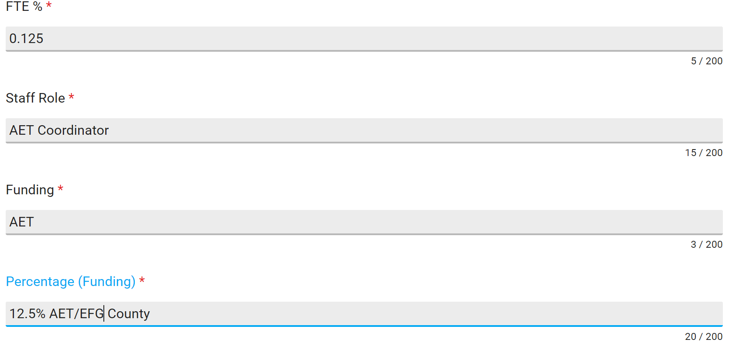
AET Coordinator: Single-Role Contract Staff
Name: Lawan Order
Full Time Equivalency (FTE): Lawan is employed full-time by the EFG County Sheriff’s Office. The EFG County Authority contracts with him to serve as AET Coordinator for the 18th Judicial Circuit at FTE = 0.25, which equally serves EFG and HIJ counties. He has one funding source: AET.
EFG COUNTY
Percentage (funding) equals the FTE % per organization in IMPACT.

Slide 27
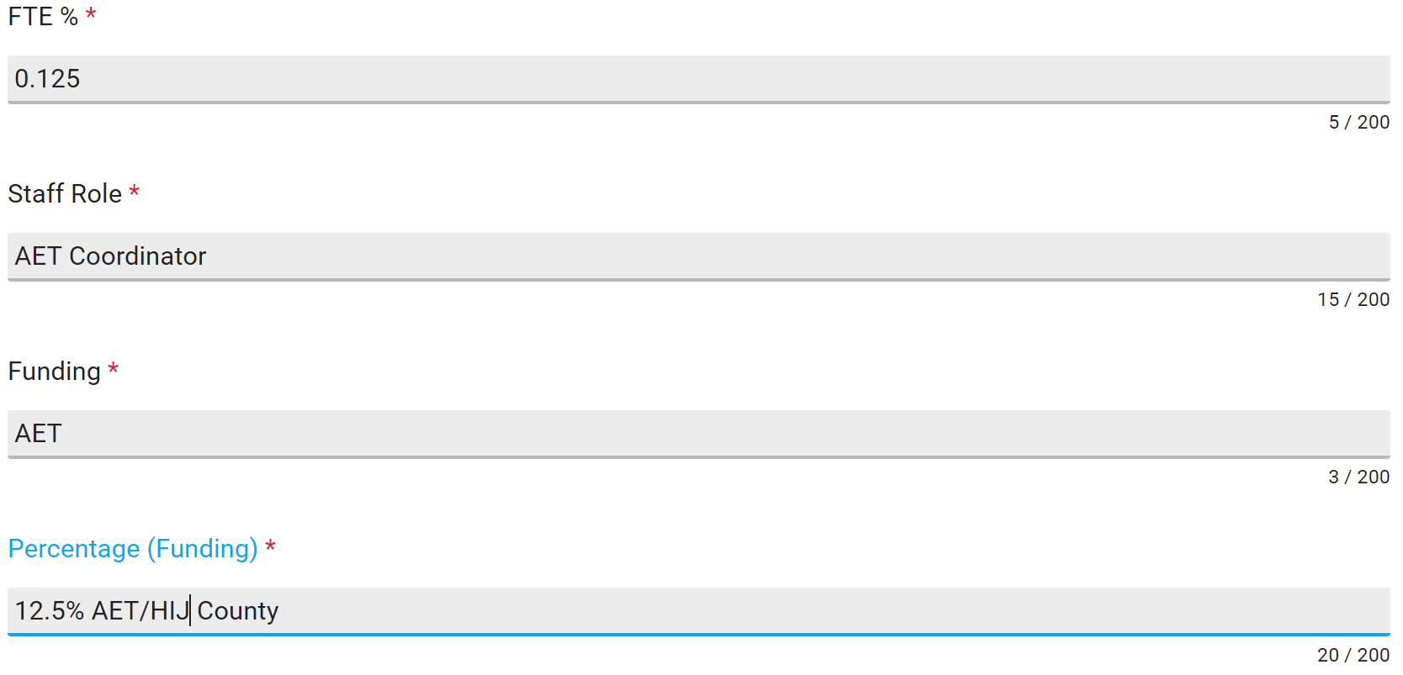
AET Coordinator: Single-Role Contract Staff
Name: Lawan Order
Full Time Equivalency (FTE): Lawan is employed full-time by the EFG County Sheriff’s Office. The EFG County Authority contracts with him to serve as AET Coordinator for the 18th Judicial Circuit at FTE = 0.25, which equally serves EFG and HIJ counties. He has one funding source: AET.
HIJ COUNTY
Percentage (funding) equals the FTE % per organization in IMPACT.

Slide 28
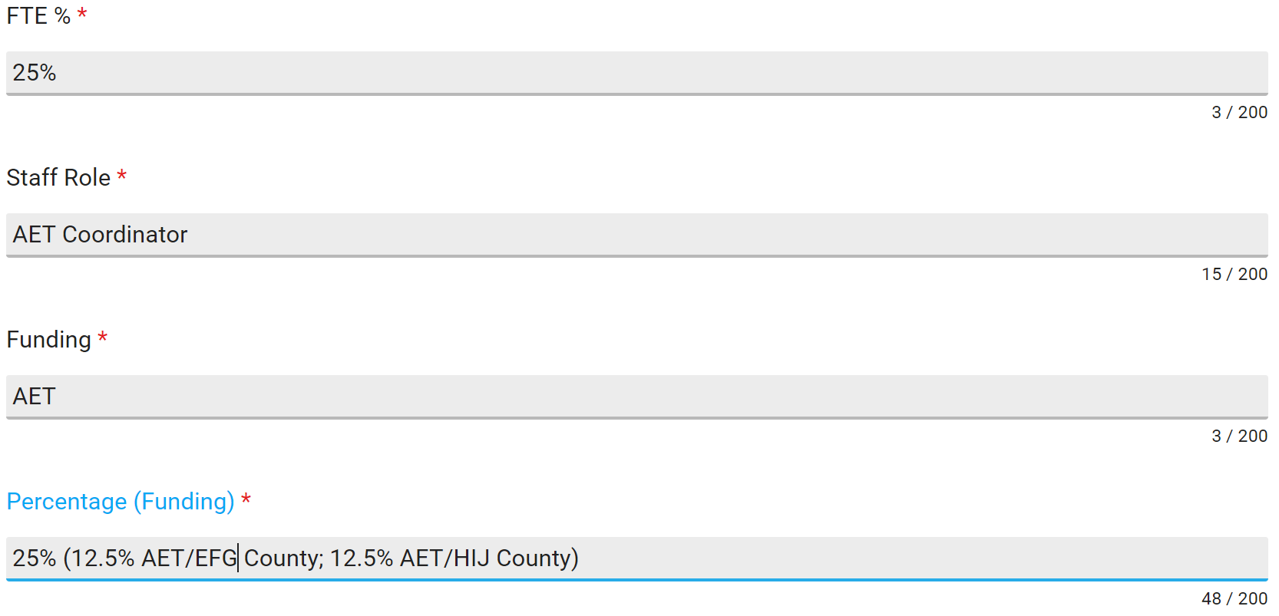
AET Coordinator: Single-Role Contract Staff
Name: Lawan Order
Full Time Equivalency (FTE): Lawan is employed full-time by the EFG County Sheriff’s Office. The EFG County Authority contracts with him to serve as AET Coordinator for the 18th Judicial Circuit at FTE = 0.25, which equally serves EFG and HIJ counties. He has one funding source: AET.
Do not repeat staff information for each organization if staff’s FTE %, staff roles, or percentage of funding varies per county in IMPACT.
XYZ COUNTY
Incorrect entry
Percentage (funding) equals the FTE % per organization in IMPACT.

Slide 29
AET Coordinator: Single-Role Contract Staff
Name: Lawan Order
Full Time Equivalency (FTE): Lawan is employed full-time by the EFG County Sheriff’s Office. The EFG County Authority contracts with him to serve as AET Coordinator for the 18th Judicial Circuit at FTE = 0.25, which equally serves EFG and HIJ counties. He has one funding source: AET.
EFG County
HIJ County
Total
FTE: 0.125 0.125 .25
Percentage: 12.5% 12.5% 25%
Total percentage (funding) equals 25% for the two counties combined.
Total percentage (funding) equals the combined FTE % of County EFG and HIJ.

Slide 30
Questions?
Notes:
Q&A Slide

Slide 31
1801 Main Street, 4th Floor • Columbia, South Carolina 29201
telephone: 803-896-5555 • fax: 803-896-5558
www.daodas.sc.gov
Notes:
Final Slide

